Slide 1
Real programs/codebases that mix blocking and non‑blocking data structures
1) Linux kernel: systematic mixing of RCU (non‑blocking for reads) with spinlock/mutex (blocking for writes/updates)
The official documentation describes idioms where reads are done in RCU read‑side critical sections, while modifications are protected by locks; see “Read‑Side Action Taken Outside of Lock” and examples of lists protected by RCU with locked insert/remove paths. This is a production example of combining non‑blocking reads and blocking writes around the same structures. [github.com], [arxiv.org]
The spinlocks documentation and concurrency overviews highlight how spinlocks/semaphores are combined with RCU across real subsystems (VFS, networking, etc.); “RCU Usage One Decade Later” summarizes the breadth of RCU usage in tandem with other primitives. [github.com], [mlir.llvm.org], [mlsys.org]
Why this is “mixing”: RCU provides non‑blocking reader access, but updating threads synchronize via blocking locks (spinlock/rwlock/seqlock), and both techniques are used together around the same lists/hash tables/trees. [github.com]
2) RocksDB: lock‑free readers + blocking write path on memtable (skiplist)
In the skiplist code for the memtable, it is stated: “Writes require external synchronization, most likely a mutex. Reads progress without any internal locking”—i.e., writes require locking (typically a DB mutex around metadata/writer coordination), while reads proceed lock‑free/non‑blocking. [fzn.fr]
The RocksDB blog (“Reducing Lock Contention”) explains that memtable is a lock‑free structure for “single writer / multiple readers”, while DB mutex is used around metadata and writer coordination—i.e., the engine combines lock‑free operations with blocking coordination. [dre.vanderbilt.edu]
Additionally, the MemTable Wiki points to skiplist as the default, and Stack Overflow discussions emphasize that lock‑free read coexists with write/metadata synchronization (or limits on simultaneous writers). [mljourney.com], [docs.pytorch.org]
3) Meta Folly: the same MPMCQueue provides both non‑blocking and blocking operations
In Folly’s MPMCQueue.h, besides non‑blocking read/write, there are blockingRead/blockingWrite/tryReadUntil/tryWriteUntil—so one structure supports both styles, and Meta uses it in production. This is internal mixing of blocking/non‑blocking semantics. [mfem.org]
Production use of MPMCQueue and its correctness (linearizability with external LPs) are shown in a mechanized verification (CPP’22), further validating real scenarios. [arxiv.org]
4) oneTBB (used in many products): concurrent_bounded_queue (blocking) alongside non‑blocking containers/scheduler
TBB/oneAPI docs describe concurrent_bounded_queue with push/pop that can block at capacity, and concurrent_queue—non‑blocking (unbounded, try_pop). These two styles are often used together in pipelines. [deepwiki.com], [homes.cs.w...ington.edu]
Practical context: TBB is widely deployed (Adobe CS, Autodesk Maya, Unreal Engine, Civilization, etc.); its runtime is work‑stealing. Real applications connect blocking queues for back‑pressure with non‑blocking task flows/containers—i.e., mixing in production. [web.eecs.umich.edu], [cs.otago.ac.nz]
5) moodycamel::ConcurrentQueue: using a lock‑free queue together with its blocking sibling
The concurrentqueue repo offers a lock‑free queue and a separate BlockingConcurrentQueue with low overhead. This is a common approach to mix sleeping consumers (blocking) and lock‑free producer paths within the same application (depending on needs). [vkdoc.net]

Slide 2
Verifying progress semantics
“bounded lock‑based queue” + “lock‑free MPMC queue/lock‑free stack” in one pipeline
Setup: In production, teams often combine heterogeneous primitives: e.g., Intel oneTBB provides a blocking concurrent_bounded_queue<T> (push/pop blocking by capacity)—a natural back‑pressure for producers; on the consumer side, teams use fast lock‑free MPMC queue from Meta Folly (widely used in production; formally verified to be linearizable in Coq/Iris: CPP’22), or a Treiber stack for cache/task layers. This is not hypothetical:
• oneTBB is an industry standard; used in Adobe Creative Suite, Autodesk Maya, Unreal Engine 3, Civilization 5, etc., and its runtime is task‑based work‑stealing (with concurrent containers and blocking/atomic primitives).
• Folly MPMC queue—actually deployed at Meta and formally verified as linearizable (with external linearization points)—i.e., not only code but confirmed semantics.
• A broad ecosystem of lock‑free structures (Boost.Lockfree, libcds, Userspace RCU, etc.) is documented, showing developers do mix different models (blocking, lock‑free, RCU) to hit required latency/back‑pressure/fairness balances. [scispace.com], [academia.edu] [pldi25.sigplan.org] [sigplan.org], [users.cs.utah.edu]
What Concur‑IR unlocks:
Static contract checks at the interface between components: if a downstream section requires “lock‑free”/“wait‑free,” but upstream uses “blocking,” we warn about potential SLA violations or perf degradation (your progress/semantics attributes in IR create a checkable contract). This is a new diagnostic impossible in plain MLIR/LLVM where progress semantics aren’t represented. [github.com]
// producer: oneTBB bounded queue (blocking push)
tbb::concurrent_bounded_queue<int> q;
q.set_capacity(1024); // back-pressure boundary q.push(item); // may block until capacity allows
/* consumer: Folly MPMC queue (lock-free) */
folly::MPMCQueue<int> mpmc(1024); // lock-free MPMC queue in Folly (used at Meta) int v;
if (mpmc.read(v)) { /* ... */ } // non-blocking semantics, linearizable queue
// bounded, blocking queue
%Q = concur.ds.create @queue<i32> { progress = "blocking", semantics = "linearizable", capacity = 1024 }
// producer push (may block)
concur.ds.enqueue %Q, %x
// lock-free MPMC consumer side
%M = concur.ds.create @mpmc_queue<i32> { progress = "lock-free", semantics = "linearizable" }
%ok, %y = concur.ds.dequeue %M
// DIAGNOSTICS: contract mismatch

Slide 3
Transactional data structures

Slide 4
Transactional Concurrent Data Structures
Motivation
Many multi-threaded systems, including those for finance, travel [30], warehouse management [6], and databases in general [39], need to compose operations into transactions that occur in an allor-nothing fashion (i.e., atomically) [1]
Theory
Herlihy and Koskinen [18] proposed transactional boosting, a (blocking) methodology that allows an STM system to incorporate operations on existing concurrent data structures.
In work concurrent to TDSL, Zhang et al. [43] proposed the Lock-Free Transactional Transform (LFTT), a nonblocking methodology to compose nonblocking data structures, based on the observation that only certain nodes—those critical to transaction semantics—really matter in conflict management. ... Subsequently, LaBorde et al. [23] proposed a Dynamic Transactional Transform (DTT) that generalizes LFTT to dynamic transactions (specified as lambda expressions). Concurrently, Elizarov et al. [8] proposed LOFT, which is similar to LFTT but avoids incorrectly repeated helping.
In [9] introduces nonblocking transaction composition (NBTC), a new methodology for atomic composition of nonblocking operations on concurrent data structures. Unlike previous software transactional memory (STM) approaches, NBTC leverages the linearizability of existing nonblocking structures, reducing the number of memory accesses that must be executed together, atomically, to only one per operation in most cases (these are typically the linearizing instructions of the constituent operations).
[1] Wentao Cai, Haosen Wen, and Michael L. Scott. 2023. Transactional Composition of Nonblocking Data Structures. In Proceedings of the 35th ACM Symposium on Parallelism in Algorithms and Architectures (SPAA '23). Association for Computing Machinery, New York, NY, USA, 187–197. https://doi.org/10.1145/3558481.3591079
[30] Chi Cao Minh, JaeWoong Chung, Christos Kozyrakis, and Kunle Olukotun. 2008.STAMP: Stanford Transactional Applications for Multi-Processing. In IEEE Intl. Symp. on Workload Characterization (IISWC). Seattle, WA, 35–46.
[6] The Transaction Processing Council. 2010. TPC-C Benchmark (Revision 5.11.0). http://www.tpc.org/tpcc/.
[39] Stephen Tu, Wenting Zheng, Eddie Kohler, Barbara Liskov, and Samuel Madden. 2013. Speedy Transactions in Multicore In-Memory Databases. In 24th ACM Symp. on Operating Systems Principles (SOSP). Farminton, PA, 18–32.
[43] Deli Zhang and Damian Dechev. 2016. Lock-Free Transactions without Rollbacks for Linked Data Structures. In 28th ACM Symp. on Parallelism in Algorithms and Architectures (SPAA). Pacific Grove, CA, 325–336.
[23] Pierre LaBorde, Lance Lebanoff, Christina Peterson, Deli Zhang, and Damian Dechev. 2019. Wait-Free Dynamic Transactions for Linked Data Structures. In 10th Intl. Workshop on Programming Models and Applications for Multicores and Manycores (PMAM). Washington, DC, 41–50
[8] Avner Elizarov, Guy Golan-Gueta, and Erez Petrank. 2019. LOFT: Lock-Free Transactional Data Structures. In 24th ACM SIGPLAN Symp. on Principles and Practice of Parallel Programming (PPoPP). Washington, DC, 425–426.

Slide 5
Transactional Concurrent Data Structures
Phase 1: The User Contract (Annotations)
The user writes a standard data structure (e.g., a Stack) but uses a special intrinsic or attribute to indicate
struct Stack {
Node *head;
void push(int val) {
Node *n = new Node(val);
// Planning Phase
while (true) {
Node *old_head = this->head; // Load
n->next = old_head;
// LINEARIZATION POINT (LP)
// The user marks the CAS.
// In normal code, this executes immediately.
// In a transaction, the compiler intercepts this.
if (__sync_linearize_cas(&this->head, old_head, n)) {
return; // Success
}
// (Automatic retry loop if outside transaction)
}
}
int pop() {
while (true) {
Node *old_head = this->head;
if (!old_head)
return -1;
Node *next = old_head->next;
// LINEARIZATION POINT
if (__sync_linearize_cas(&this->head, old_head, next)) {
delete old_head; // Cleanup Phase
return old_head->val;
}
}
}
};
// TRANSACTION
void move_atomic(Stack &s1, Stack &s2) {
// The user simply writes logic
__sync_transaction {
int val = s1.pop();
if (val != -1) {
s2.push(val);
}
}
}

Slide 6
Transactional Concurrent Data Structures
Phase 2: Compiler Magic (Transformation Pipeline)
The compiler must perform Slicing on the push and pop functions. It divides the code into three parts:
Generator (Planning): Code before the linearization point (calculating new values).
Critical (Execution): The linearization point itself (address, expected value, new value).
Post-Op (Cleanup): Code after success (deleting nodes, updating counters).
How the compiler transforms move_atomic:
It inlines calls and assembles an MCNS Descriptor (Multi-Compare-N-Swap).
// --- Step 2: Execute s2.push(val) (Speculatively) ---
Node *n = new Node(val);
Node *s2_head_old;
do {
s2_head_old = atomic_load(s2.head); // Tracking Read
n->next = s2_head_old;
// Again, NO CAS performed yet.
} while (!validate_read(s2.head, s2_head_old));
// Add intent:
// "I want to replace s2.head from s2_head_old to n"
mcns_add_entry(desc, &s2.head, s2_head_old, n);
// --- Step 3: Atomic Commit (MCNS) ---
// The magic function that executes all CASes at once
bool success = mcns_commit(desc);
if (success) {
// --- Step 4: Cleanup (executed only on success) ---
// From s1.pop():
delete s1_head_old;
// From s2.push(): nothing (n is now in the list)
} else {
// Rollback
delete n; // We created a node but didn't insert it; must delete.
goto retry; // Restart the whole transaction
}
}
void move_atomic_impl(Stack &s1, Stack &s2) {
Descriptor *desc = mcns_alloc_descriptor();
// --- Step 1: Execute s1.pop() (Speculatively) ---
Node *s1_head_old;
Node *s1_next;
int val;
// "Soft" Read Retry Loop
do {
s1_head_old = atomic_load(s1.head); // Tracking Read
if (!s1_head_old)
goto abort; // Stack empty, branch logic
s1_next = s1_head_old->next;
val = s1_head_old->val;
// We do NOT perform CAS. We record the intent.
} while (!validate_read(s1.head, s1_head_old));
// Add intent to descriptor:
// "I want to replace s1.head from s1_head_old to s1_next"
mcns_add_entry(desc, &s1.head, s1_head_old, s1_next);

Slide 7
More Precise Static Race/Deadlock Analysis
Problem with Current Approach: ThreadSanitizer (TSAN) and static analyzers (RacerD, Infer) work at the IR level, where concurrency semantics are blurred. For example, lock-free structures look like ordinary CAS loops without context.
What Concur Dialect Provides:
Eliminating False Positives: If the analyzer sees concur.ds.enqueue %Q {progress="lock-free"}, it knows this is not a data race, but a correct lock-free operation.
Context-Sensitive Analysis: For concur.guard.begin/end, the compiler builds a precise lock-order graph
Real-World Example: …
Concrete Scenario:
// Before: TSAN reports a race
%x = load %ptr : i32 // Thread A
store %val, %ptr : i32 // Thread B, inside RCU
// After: TSAN understands the context
%epoch = concur.epoch.enter
%x = load %ptr : i32 // Protected by epoch
concur.epoch.exit %epoch

Slide 8
Memory Reclamation Optimization
Scenario from Real Code (folly::ConcurrentHashMap at Facebook):
// Before: each operation acquire/release HP
for %i in 0..N {
%hp = concur.hp.acquire %nodes[%i]
concur.hp.release %hp
concur.defer.free %nodes[%i] {scheme="hp"}
}
// After: compiler batches into epoch-based:
%epoch = concur.epoch.enter
for %i in 0..N {
concur.defer.free %nodes[%i] {scheme="ebr"}
}
concur.epoch.exit %epoch
Justification: [Cohen et al., PPoPP'15 "Efficient Memory Reclamation"] [Wen et al., PPoPP’18 Interval-Based Memory Reclamation]

Slide 9
Hints/annotation-based optimizations

Slide 10
Hints/annotations-based optimization
Contention Hints (sync::contention)
Scenario: A central task queue in a thread pool. The user knows this lock will be hammered by 64 threads, so a standard mutex will collapse performance due to cache line bouncing.
Before
After
The compiler replaces the mutex with an MCS Lock (queue-based spinlock), where each thread spins on its own local cache line..
class TaskQueue {
// Hint: High contention expected. Do not use futex/pthread_mutex.
[[sync::contention("high")]]
std::mutex lock;
std::deque<Task> tasks;
public:
void push(Task t) {
lock.lock();
tasks.push_back(t);
lock.unlock();
}
};
// Compiler injects MCS lock
class TaskQueue {
MCSLock lock;
std::deque<Task> tasks;
public:
void push(Task t) {
lock.lock();
tasks.push_back(t);
lock.unlock();
}
};
User Intent: The programmer knows whether a lock is a "hot spot" (accessed by 100 threads constantly) or a "cold spot" (accessed once per hour).
Annotation: [[sync::contention("high" | "low" | "bursty")]]
Target: Locks, Atomic Variables, Critical Sections.
Transformations:
High Contention:
  Mutex Substitution: Replace std::mutex (usually a simple futex) with MCS Lock or CLH Lock (queue-based locks). These spin on local cache lines, preventing "thundering herd" problems and bus saturation.
  Flat Combining: If applied to a data structure, switch to a Flat Combining mode (one thread performs work for everyone).
  Backoff Injection: Automatically inject exponential backoff logic into CAS loops.
Low Contention:
  Slim Locks: Use a simple Test-and-Set (TAS) spinlock or even a 1-byte flag. Minimizes memory footprint and instruction count (latency).
  Inlining: Aggressively inline the critical section logic, assuming no collision.
Bursty:
  Adaptive Locks: Generate code that starts as a TAS lock but inflates to a Queue Lock if it detects a collision.

Slide 11
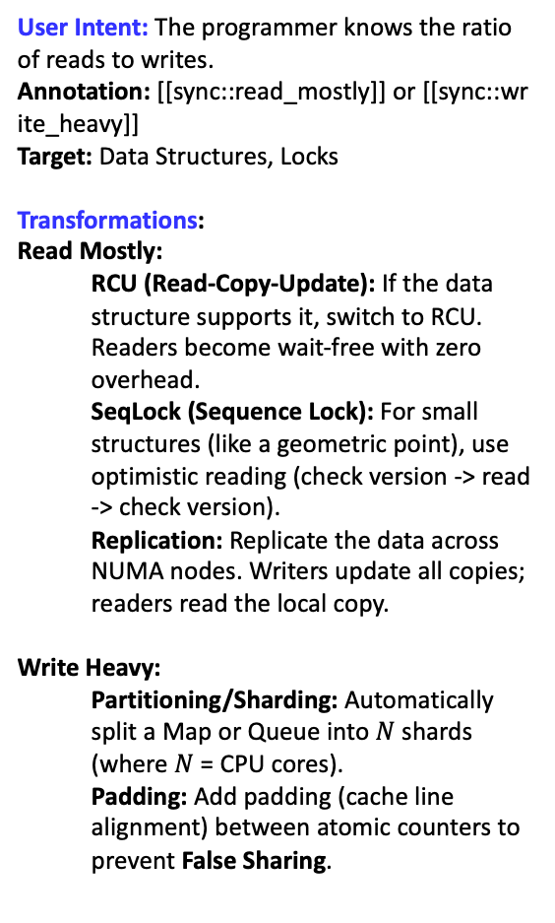
Hints/annotations-based optimization
2. Access Pattern Hints (sync::read_mostly)
Scenario: A configuration object that is read frequently by worker threads but updated rarely (e.g., once a day).
User Intent: The programmer knows the ratio of reads to writes.
Annotation: [[sync::read_mostly]] or [[sync::write_heavy]]
Target: Data Structures, Locks
Transformations:
Read Mostly:
  RCU (Read-Copy-Update): If the data structure supports it, switch to RCU. Readers become wait-free with zero overhead.
  SeqLock (Sequence Lock): For small structures (like a geometric point), use optimistic reading (check version -> read -> check version).
  Replication: Replicate the data across NUMA nodes. Writers update all copies; readers read the local copy.
Write Heavy:
  Partitioning/Sharding: Automatically split a Map or Queue into $N$ shards (where $N$ = CPU cores).
  Padding: Add padding (cache line alignment) between atomic counters to prevent False Sharing.
Before
After
The compiler eliminates the mutex for readers entirely, replacing it with Sequential Locking (optimistic reading).
struct [[sync::read_mostly]] ServerConfig {
int timeout_ms;
int max_retries;
std::mutex mtx; // User writes standard mutex code
int get_timeout() {
std::lock_guard<std::mutex> l(mtx);
return timeout_ms;
}
};
struct ServerConfig {
int timeout_ms;
int max_retries;
atomic_size_t seq; // Version counter
};
int get_timeout_optimized(ServerConfig *cfg) {
int val;
size_t v1, v2;
do {
// 1. Read version (must be even)
v1 = atomic_load(&cfg->seq, memory_order_acquire);
if (v1 % 2 != 0) {
_mm_pause();
continue;
} // Writer is active
// 2. Optimistic Read (No lock!)
val = cfg->timeout_ms;
// 3. Verify version hasn't changed
atomic_thread_fence(memory_order_acquire);
v2 = atomic_load(&cfg->seq, memory_order_relaxed);
} while (v1 != v2);
return val;
}

Slide 12
Hints/annotations-based optimization
3. Topology Hints (sync::topology)
Before
A dedicated communication channel between a rendering thread and a logic thread
After (Lamport Ring)
The compiler removes LOCK XCHG or CAS instructions.
User Intent: The programmer knows which threads interact with which data.
Annotation: [[sync::single_producer]], [[sync::single_consumer]], [[sync::thread_local]].
Transformations:
Single Producer / Single Consumer (SPSC):
  If a queue is marked SPSC, the compiler replaces the standard CAS-based queue with a Lamport Ring Buffer (requires only memory barriers, no heavy atomic RMW instructions). This is 2-3x faster.
Thread Local (Escaping):
  If an object is marked as "mostly thread local", the compiler can use Biased Locking. The lock is "biased" to the creating thread (zero atomic cost). If another thread tries to touch it, the lock is "revoked" (expensive, but rare).
struct SPSCQueue {
atomic_size_t head, tail;
Frame *buffer[1024];
};
void submit_frame_optimized(SPSCQueue *q, Frame *f) {
size_t t = atomic_load(&q->tail, memory_order_relaxed);
size_t h = atomic_load(&q->head, memory_order_acquire);
if (t - h >= 1024) return; // Full
q->buffer[t % 1024] = f;
// Store-Release is sufficient! No atomic RMW needed.
atomic_store(&q->tail, t + 1, memory_order_release);
// Hint: Single Producer, Single Consumer
[[sync::topology("spsc")]]
ConcurrentQueue<Frame *> render_queue;
void submit_frame(Frame *f) { render_queue.push(f); }
Before
A Session object is created by a worker thread and processed almost exclusively by that same thread
After (Biased locking)
struct BiasedLock {
uint64_t header; // Contains: ThreadID (54 bits) |
// Locked (1 bit) | Bias_Enabled (1 bit) };
void process_request_optimized(Session *s) {
uint64_t current_tid = get_thread_id();
// 1. Check if the lock is biased towards US
// This is a plain LOAD. No cache coherency traffic.
uint64_t hdr = s->mtx.header;
if ((hdr & BIAS_MASK) == current_tid) {
// --- FAST PATH (Owner) ---
// We own the bias! Just set the "Locked" bit.
// NO ATOMIC INSTRUCTIONS. Just a plain store.
s->mtx.header = hdr | LOCKED_BIT;
s->request_count++; // Critical Section
s->mtx.header = hdr & ~LOCKED_BIT; // Unlock
} else {
// --- SLOW PATH (Contender / Revocation) ---
// Either the lock is unbiased, or biased to someone else.
// We must atomically revoke the bias and upgrade to a full lock.
slow_path_lock(&s->mtx);
s->request_count++;
slow_path_unlock(&s->mtx);
}
}
// Hint: This object mostly stays on one thread, but might be accessed by
// others.
[[sync::locality("biased")]]
std::mutex mtx;
int request_count = 0;
void process_request() {
// The owner calls this millions of times.
// Standard mutex would execute millions of atomic CAS instructions.
std::lock_guard<std::mutex> lock(mtx);
request_count++;
}
// Called rarely by a background thread
int get_count() {
std::lock_guard<std::mutex> lock(mtx);
return request_count;
}

Slide 13
Hints/annotations-based optimization
4. Temporal Hints (sync.latency)
User Intent: Does this operation need to finish NOW, or can it wait?
Annotation: [[sync::latency_critical]] vs [[sync::throughput_oriented]]
Transformations:
Latency Critical:
  Busy Wait: Use spinlocks. Never put the thread to sleep (syscall futex_wait), because waking up takes 10-20 microseconds.
  Prefetching: Issue prefetchw (prefetch for write) instructions well before the lock acquisition.
Throughput Oriented:
  Combining: Use Flat Combining or Scheduler-based locking. Allow threads to sleep and batch their requests.
Before
High-Frequency Trading (HFT) or Audio Processing callback. Waiting for the OS scheduler is unacceptable.
After
The compiler generates a busy-wait loop that never calls syscall(FUTEX_WAIT).
void on_market_data() {
// Hint: Do not yield/sleep.
// Burn CPU cycles if needed.
[[sync::latency("critical")]]
std::lock_guard<std::mutex> lock(order_book_mutex);
process_tick();
}
void on_market_data() {
// Hint: Do not yield/sleep.
// Burn CPU cycles if needed.
[[sync::latency("critical")]]
std::lock_guard<TTSLock> lock(order_book_mutex);
process_tick();
}

Slide 14
Optimizations around critical sections

Slide 15
Critical Section Coarsening
Real-world scenario: Packet processing, updating metrics or histograms. Often found in network code (DPDK, Nginx modules) or high-performance computing where there is a global counter or state structure.
Before
After
The compiler notices that compute_bin is a pure function and the loop has no side effects that block the thread.
// Updating a global histogram from a thread
void update_histogram(int *data, int count, GlobalStats *stats) {
for (int i = 0; i < count; ++i) {
int bin = compute_bin(data[i]);
// Entering the critical section on every iteration.
// This causes cache-line bouncing of the mutex between cores.
pthread_mutex_lock(&stats->mutex);
stats->bins[bin]++;
pthread_mutex_unlock(&stats->mutex);
}
}
void update_histogram(int *data, int count, GlobalStats *stats) {
// Lock once. Yes, the lock is held longer,
// but throughput increases manifold.
pthread_mutex_lock(&stats->mutex);
for (int i = 0; i < count; ++i) {
int bin = compute_bin(data[i]);
stats->bins[bin]++;
}
pthread_mutex_unlock(&stats->mutex);
}
Why Coarsen Critical Sections (Lock Coarsening)?
Your argument: Fine-grained is better for concurrency.
Counter-argument: Fine-grained kills single-thread latency and causes cache-line ping-pong.
Yes, this gives other threads a chance to intervene. But:
Atomic Overhead: The LOCK prefix instruction itself (x86) or LDXR/STXR (ARM) costs tens to hundreds of cycles.
Cache Coherency Traffic: If two threads are fighting for this lock, the cache line containing the mutex will bounce between cores (ping-pong) on every iteration. This kills the bus.
Optimization: Acquire the lock once before the loop.
Yes, we increase the contention window, but we decrease the program's total execution time by removing thousands of atomic operations. The Java HotSpot JIT does this (Lock Coarsening), but LLVM does it very cautiously because it is afraid of turning parallel code into serial code. In MLIR, having profiling data or loop semantics allows for more aggressive decisions.

Slide 16
Better selection of lock algorithms: Read-write lock promotion as example
Real-world scenario: Caches, configurations, routing tables.
Code is often written with std::mutex because "it's simpler" and "just in case." But 99% of the time, this code only reads data.
Before
After
To replace a Mutex with a RWLock (Read-only), you need to prove that there are no writes to shared memory in the critical section.
int get_config(Config *cfg, char *key) {
// A simple mutex blocks both readers and writers
pthread_mutex_lock(&cfg->mtx);
int val = lookup_map(cfg->map, key); // Read-only!
pthread_mutex_unlock(&cfg->mtx);
return val;
}
int get_config(Config *cfg, char *key) {
// If lookup_map is guaranteed not to change the map
pthread_rwlock_rdlock(&cfg->rwlock);
int val = lookup_map(cfg->map, key);
pthread_rwlock_unlock(&cfg->rwlock);
return val;
}

Slide 17
Propagation of relaxation

Slide 18
Propagation of relaxation
1. Vector "Bottom-Up": From Data to Structure (Queue $→$ Multi-Queue/Bag)
Scenario: A pool of worker threads processing independent tasks (e.g., a web crawler or fuzzing).
Core Idea: The task data is marked as fungible (interchangeable) or order_insensitive. This infects the container holding them. Since strict FIFO order is irrelevant for such data, the compiler replaces the single high-contention Strong Queue with a scalable Multi-Queue (or Distributed Bag).
Before (naïve implementation)
The programmer uses a standard thread-safe queue.
After
The compiler sees the order_insensitive attribute and replaces the implementation with a Multi-Queue (Randomized Load Balancing).
struct Task {
char url[256];
};
// Global queue protected by a single mutex.
// SCALABILITY BOTTLENECK: All threads fight for this lock.
ThreadSafeQueue<Task> worklist;
void submit_task(Task t) {
// Strict synchronization. Guarantees FIFO, which is useless here.
queue_push(&worklist, t);
}
// Generated: A set of N independent queues (sharded by thread ID or CPU).
struct Shard {
ThreadSafeQueue q;
char pad[64];
}; // Padding to avoid false sharing
Shard shards[NUM_CPUS];
void submit_task(Task t) {
// Optimization: Pick a random shard or the current thread's shard.
// Contention is reduced by factor of NUM_CPUS.
int shard_id = get_thread_id() % NUM_CPUS;
// We use a simpler lock (spinlock) because contention is low.
// Order is now only "locally FIFO", globally chaotic.
spin_lock(&shards[shard_id].q.lock);
queue_push_unsafe(&shards[shard_id].q, t);
spin_unlock(&shards[shard_id].q.lock);
}

Slide 19
Propagation of relaxation
2. Vector "Top-Down": From Structure to Atomics
Scenario: Audio streaming Ring Buffer.
Core Idea: The user explicitly marks the buffer as lossy (tolerates artifacts/glitches). This requirement flows down to the hardware level, downgrading atomic instructions by removing memory barriers.
Before (Before: Standard SPSC Buffer)
Standard lock-free implementation requires fences.
After
Relaxed.
void audio_push(RingBuf *rb, float sample) {
uint32_t tail = atomic_load(&rb->tail, memory_order_relaxed);
rb->buffer[tail % SIZE] = sample;
// Release Barrier! (Store-Release).
// Guarantees sample is visible BEFORE the tail update.
// On ARM, this generates 'stlr' (more expensive).
atomic_store(&rb->tail, tail + 1, memory_order_release);
}
void audio_push_relaxed(RingBuf *rb, float sample) {
uint32_t tail = atomic_load(&rb->tail, memory_order_relaxed);
rb->buffer[tail % SIZE] = sample;
// Barrier Removed!
// The CPU may reorder writing the tail before the sample.
// Risk: Reader sees new tail but old garbage data in the buffer.
// Verdict: Allowed because the structure is marked "lossy". Faster execution.
atomic_store(&rb->tail, tail + 1, memory_order_relaxed);
}

Slide 20
Propagation of relaxation
3. Vector "Lateral": From Atomics to Logic (Coalescing)
Scenario: Analytics / Visit Counter.
Core Idea: A counter is marked as approx (approximate). This infects the control flow. The compiler realizes that intermediate states of the counter are irrelevant to other threads, so it coalesces multiple atomic updates into a single one (ignoring visibility during the loop).
Before (strict loop).
After
Loop Coalescing
atomic_int visits = 0;
void process_batch(int count) {
for (int i = 0; i < count; ++i) {
// Each iteration hits the cache coherence bus.
// Other threads see every intermediate value (1, 2, 3...).
atomic_fetch_add(&visits, 1);
}
}
void process_batch(int count) {
// Compiler hoisted the increment out of the loop.
// We lost "progress visibility" for other threads during the loop.
// But since 'visits' is "approx", this is legal!
// Ordinary arithmetic in a register
int local_sum = 0;
for (int i = 0; i < count; ++i) {
local_sum += 1;
}
// ONE atomic update at the end
atomic_fetch_add(&visits, local_sum, memory_order_relaxed);
}

Slide 21
Propagation of relaxation
4. Vector "Composition": Structure → Structure (Chained Infection)
Scenario: A two-stage pipeline. Stage 1 is a Work-Stealing Queue (inherently unordered/chaotic). Stage 2 is a Database Writer Queue.
Core Idea: Since the data coming out of Stage 1 is already "shuffled" (random order due to work stealing), enforcing strict FIFO in Stage 2 is semantically meaningless. The "chaos" from the first structure infects the second.
Before (Weak Source → Strong Sink).
After (Propagation)
// Source: Work Stealing Queue (Order is non-deterministic)
Task t = wsq_pop(my_queue);
// Sink: Database Queue
// PROBLEM: We use a global lock to enforce FIFO,
// even though the input 't' arrived in a random order.
mutex_lock(&db_q.lock);
queue_push(&db_q, t);
mutex_unlock(&db_q.lock);
Task t = wsq_pop(my_queue);
// Optimization: Replace the global DB queue with Sharded Queues.
// We write to a local shard. The DB Writer thread will just poll all shards.
// Strict global ordering is gone, but it didn't exist anyway!
multiqueues_push(t);

Slide 22
Concurrency pattern optimization

Slide 23
Multithreading pattern optimization
1. Pipeline Pattern (CDS Fusion / Batching)
Scenario: Data flows from Queue A to Queue B with some processing in between.
Scheme: Source -> [Q1] -> Worker A -> [Q2] -> Worker B -> Sink
Optimization: Instead of locking twice for every single element, the compiler applies "Loop Tiling" to the dataflow, creating a local buffer to process items in batches.
Before (Element-wise).
After (Batched)
void worker(Queue *q_in, Queue *q_out) {
while (true) {
// High lock contention: 2 locks per 1 item
Item val;
if (queue_pop(q_in, &val)) { // Lock A
Item res = process(val);
queue_push(q_out, res); // Lock B
}
}
}
void worker_optimized(Queue *q_in, Queue *q_out) {
Item buffer[16]; // Thread-local buffer
while (true) {
// Bulk transfer: 1 lock per 16 items
int count = queue_pop_batch(q_in, buffer, 16);
// Processing happens entirely in L1 cache, no locks
for (int i = 0; i < count; ++i) {
buffer[i] = process(buffer[i]);
}
if (count > 0) {
queue_push_batch(q_out, buffer, count); // Lock B
}
}
}

Slide 24
Multithreading pattern optimization
2. Feedback Loop Pattern (Thread-Local Retry)
Scenario: A worker pops a task, tries to execute it, fails (e.g., resource busy), and pushes it back to retry later.
Scheme: Worker -> [Main Queue] -> Worker
Optimization: Pushing back to the global queue destroys cache locality and increases contention. The compiler injects a "Side Stack" to keep retries local.
Before (Naïve retry).
After (Short-Circuit)
void worker(Queue *global_q) {
Task t = queue_pop(global_q);
if (!try_execute(t)) {
// Bad: Contenting for the lock again, losing cache warmth
queue_push(global_q, t);
}
}
// Compiler injects thread-local storage
__thread Task retry_stack[8];
__thread int stack_ptr = 0;
void worker(Queue *global_q) {
Task t;
// 1. Check local stack first (Zero cost)
if (stack_ptr > 0) {
t = retry_stack[--stack_ptr];
} else {
t = queue_pop(global_q);
}
if (!try_execute(t)) {
// 2. Push to local stack instead of global
if (stack_ptr < 8) {
retry_stack[stack_ptr++] = t;
} else {
// Fallback only if stack is full
queue_push(global_q, t);
}
}
}

Slide 25
Multithreading pattern optimization
3. Fan-out Pattern (Topology Matching)
Scenario: Data is distributed to multiple queues based on a hash (Sharding).
Scheme: Source -> [Map] -> (key hash) -> [Q1, Q2, Q3 ... Qn]
Optimization: Since sharding already breaks global strict ordering, the individual destination queues do not need to enforce strict FIFO relative to each other. The compiler weakens the destination queues.
Before (Naïve retry).
After (Relaxed)
// Array of 8 strict queues
Queue shards[8];
void router(Data d) {
int idx = hash(d) % 8;
// Standard locked push. Enforces FIFO,
// even though 'd' arrived here randomly via hash.
queue_push_strict(&shards[idx], d);
}
void router(Data d) {
int idx = hash(d) % 8;
// Compiler substitutes implementation.
// Uses a spinlock or lock-free push with relaxed atomics,
// because the "Global Order" was destroyed by the hashing operation.
queue_push_relaxed(&shards[idx], d);
}

Slide 26
Multithreading pattern optimization
4. Fan-in Pattern (Specialization: MPMC → MPSC)
Scenario: Multiple producer threads write to a queue; only ONE consumer thread reads from it.
Scheme: [Worker 1..N] -> [Global Atomic Counter / Queue]
Optimization: Standard libraries provide MPMC (Multi-Producer Multi-Consumer) queues by default. The compiler analyzes the call graph, sees only one consumer, and swaps the implementation for a wait-free MPSC buffer.
Before (Generic).
After (Specialized)
// Standard mutex-based queue (handles N writers, M readers)
std::queue<Data> q;
std::mutex mtx;
void producer() { lock(mtx); q.push(...); unlock(mtx); }
void consumer() { lock(mtx); q.pop(); unlock(mtx); }
// Optimized MPSC Ring Buffer (Wait-free for consumer)
struct MPSCQueue {
atomic_size_t head, tail;
Data buf[];
};
void producer() {
// Still needs atomic CAS (multiple producers)
mpsc_push(&q, ...);
}
void consumer() {
// Wait-free! No locks, just atomic load of tail.
// Huge performance gain.
mpsc_pop_unsafe(&q);
}

Slide 27
Safe memory reclamation

Slide 28
Why SMR matters in production
RCU — ubiquitous in Linux:
The survey by McKenney/Boyd-Wickizer shows that over a decade, RCU has become a fundamental kernel synchronization mechanism (thousands of uses), and understanding RCU is “a prerequisite” for understanding Linux performance; the official RCU Handbook documents API, memory guarantees, and engineering practices (barriers, grace periods, callback offloading). [pdos.csail.mit.edu], [kernel.org]
RCU – is the part of C++26 standard library [https://en.cppreference.com/w/cpp/header/rcu.html]
Support in commercial distributions:
Red Hat documents RCU tuning (callback offloading, housekeeping CPUs), which is typical for operational production environments where latency and “noisy neighbor” issues are real. [docs.redhat.com]
Standardization in C++:
Hazard pointers are included in C++26 (WG21 P2530R3) based on years of production use in Facebook Folly, moving SMR from “research technique” to a language-level feature; <hazard_pointer> is part of the standard library. [open-std.org], [en.cppreference.com]
Major production libraries:
The HP implementation in Folly — “heavy use in production since 2017” (WG21 wording) — confirms the maturity of the approach and its demand beyond the OS kernel. [open-std.org]
Rust ecosystem:
EBR in crossbeam-epoch is the de facto standard for lock-free structures in Rust; documentation and community articles describe the “pin → access → defer/free” model and practical reclamation scheduling. [github.com], [docs.rs]

Slide 29
Why SMR matters in production – publications
EBR vs. allocators: “batch free can be harmful”
PPoPP’24 (Waterloo) shows that batch freeing, typical for EBR and some SMR algorithms, bypasses caching/amortization mechanisms in modern allocators → latency spikes and degradation; proposes simple “stretching” of frees over time and lightweight token-passing EBR, giving 1.5–2.6× speedup on a 192-thread machine. Full version — arXiv. [aturon.github.io], [conf.researchr.org]
2. “Publish-on-Ping” and NBR/NBR+: reducing fence overhead in HP/HE
New line of work (Waterloo, 2024–2025): reactive publication of protected references on demand (via POSIX signals) — instead of eager publication before every read; as a drop-in replacement for HP/HE, gives 1.2–4× speedup, and EpochPOP approaches EBR while preserving HP robustness. [arxiv.org], [arxiv.org]
3. Formal specifications of HP/RCU based on Concurrent Separation Logic
OOPSLA’23 formalizes modular specifications of HP and RCU (Iris/Coq) and for the first time shows verification of realistic structures together with reclamation (Harris/Harris-Michael list, Chase-Lev deque, RDCSS), paving the way for “type-state/contract” checks at compiler level. [uwspace.uwaterloo.ca]
4. Linearizability under weak memory — recipes and automation
PLDI’24 (“Proof recipe … in relaxed memory separation logic”) — proof methodology for Michael-Scott queue, elimination stack, and Folly MPMC under RMC; POPL’25 (RELINCHE) — automatic linearizability checking under RMC (bounded but practically scalable). Not SMR per se, but critical for integrating SMR with real memory models and compiler transformations. [iris-project.org], [iris-project.org]
5. HP for optimistic traversals: validating “marked” nodes
POPL’25 proposes HP validation strategy compatible with optimistic traversals of trees/lists/skip-lists, with correctness in Iris and competitive performance to state-of-the-art SMR. [POPL]
6. Benchmarking SMR as infrastructure
SMR-benchmark (KAIST) aggregates implementations of HP/HP++, HP-BRCU, NBR+, VBR, EBR/PEBR and a set of structures, useful for compiler regression and A/B evaluations. [iris-project.org]
7. Structure-specific schemes
Margin Pointers (PPoPP’21) for search structures: guaranteed bounded “garbage memory” with low overhead; useful where EBR/HP are hard to integrate into traversal algorithms. [github.com]

Slide 30
Verifying/sanitizing hazard pointers
struct Node : std::hazard_pointer_obj_base<Node> {
int value;
std::atomic<Node*> next{nullptr};
explicit Node(int v) : value(v) {}
};
class LockFreeStack {
std::atomic<Node*> head{nullptr};
public:
void push(int v) {
Node* n = new Node(v);
// Link the new node to current head.
n->next.store(
head.load(std::memory_order_relaxed), std::memory_order_relaxed);
// Publish with CAS; release ensures 'value' and 'next’
// are visible to the popper.
while (!head.compare_exchange_weak(
n->next,
n,
std::memory_order_release,
std::memory_order_relaxed)) {
// CAS failed; n->next was updated to current
// head by compare_exchange_weak.
}
}
std::optional<int> pop() {
// Create a NONEMPTY hazard pointer guard. (Required.)
auto hp = std::make_hazard_pointer();
for (;;) {
// Protect the current head atomically and get a stable pointer to it.
Node* old = hp.protect(head); // returns a hazard-protected Node*
if (!old) return std::nullopt;
Node* next = old->next.load(std::memory_order_relaxed);
// Attempt to remove 'old' from the stack.
if (head.compare_exchange_weak(
old, next,
std::memory_order_acquire,
std::memory_order_relaxed)) {
int v = old->value; // Safe while 'old' is hazard-protected.
// Defer reclamation of 'old' to the HP library (default deleter: delete).
old->retire(); // will be freed when no HP protects it
// Now allow the library to reclaim 'old' when appropriate.
hp.reset_protection();
return v;
}
// CAS failed: head changed, loop and re-protect the new head.
}
}
};

Slide 31
Verifying/sanitizing hazard pointers
Mistake #1 — Using an empty hazard pointer
Buggy code:
std::hazard_pointer hp; // EMPTY guard (default ctor)
Node* old = hp.protect(head); // ❌ Incorrect: only nonempty guards may protect
Why this is wrong: A default‑constructed std::hazard_pointer is empty. Only nonempty guards (created via std::make_hazard_pointer()) can protect objects. Using an empty guard leads to invalid behavior. [open-std.org]
Fix:
auto hp = std::make_hazard_pointer(); // ✅ nonempty guard
Node* old = hp.protect(head); // safe: 'old' is now hazard‑protected
Mistake #2 — Accessing a node without protecting it
Buggy code:
auto hp_head = std::make_hazard_pointer();
Node* head_ptr = hp_head.protect(head); // protects 'head_ptr'
Node* next_ptr = head_ptr->next.load(); // ❌ not protected
int x = next_ptr->value; // use-after-free risk if 'next_ptr' retired
Why this is wrong: Hazard protection covers the object you protected (head_ptr), not arbitrary pointers you later read from it. Another thread may retire and reclaim next_ptr concurrently. You must protect each node you plan to dereference. [open-std.org]
Fix:
auto hp_head = std::make_hazard_pointer();
Node* head_ptr = hp_head.protect(head);
auto hp_next = std::make_hazard_pointer();
Node* next_ptr = hp_next.protect(head_ptr->next); // ✅ protect the atomic 'next' before deref
int x = next_ptr->value; // safe while hp_next protects 'next_ptr'
hp_next.reset_protection();
hp_head.reset_protection();

Slide 32
SMR-related optimizations: Hazard pointers
1) Shaping of protected regions (protect‑region shaping)
Idea: reduce the number of HP publications and fences via hoist/sink and fusion of protections.
Hoisting protect out of loop bodies and sinking reset_protection past the last use to cut expensive publications (and fences). This is possible if data‑flow analysis proves the same atomic<T*> is repeatedly read and dereferenced only after a successful protection.
Sources: interface and semantics of protect/try_protect — P2530R3, cppreference.
Batch‑protect: replace a series of independent protect calls with a batched form when the Hazard Pointer Batches extension (proposal P3428R0) is available. This can reduce domain operations and publications. Source: P3428R0.
Before (pattern with unnecessary publication):
After (use try_protect + hoist/sink):
auto hp = std::make_hazard_pointer();
for (;;) {
Node* p = hp.protect(head); // publish every iteration
Node* n = p->next.load(std::memory_order_relaxed);
if (head.compare_exchange_weak(p, n,
std::memory_order_acquire, std::memory_order_relaxed)) {
p->retire();
hp.reset_protection();
break;
}
hp.reset_protection(); // extra reset
}
auto hp = std::make_hazard_pointer();
Node* p = nullptr;
for (;;) {
if (!hp.try_protect(p, head)) continue; // publish only when pointer is stable
Node* n = p->next.load(std::memory_order_relaxed);
if (head.compare_exchange_weak(p, n,
std::memory_order_acquire, std::memory_order_relaxed)) {
p->retire(); // schedule safe reclamation
break; // hazard remains protected until exit
}
// loop retries; hp keeps protection until next try_protect succeeds or scope ends
}
hp.reset_protection(); // single sink at the end

Slide 33
SMR-related optimizations: Optimize publications
2) Replacing “eager” publication with “reactive” (HP→NBR/NBR+ / Publish‑on‑Ping)
Idea: stop publishing protection before every read — publish on demand, lowering fence overhead.
The Waterloo line of work (2024–2025) shows Publish‑on‑Ping / NBR/NBR+ as a drop‑in replacement for HP/HE with 1.2–4× speedups and an EpochPOP variant that approaches EBR performance while retaining HP‑like robustness. A compiler can:
(a) detect patterns of “eager protect in every iteration”;
(b) switch them to library APIs of NBR+, if the target platform/runtime supports them (with proven protocol equivalence).
Before:
After
struct Entry : std::hazard_pointer_obj_base<Entry> {
int key, value;
std::atomic<Entry*> next{nullptr};
};
std::atomic<Entry*> table_head{nullptr};
int lookup_hp(int k) {
auto hp = std::make_hazard_pointer();
for (Entry* e = hp.protect(table_head); e; e = hp.protect(e->next)) { // publish each step
if (e->key == k) {
hp.reset_protection();
return e->value;
}
}
hp.reset_protection();
return -1;
}
struct Entry : std::rcu_obj_base<Entry> { // intrusive RCU
int key, value;
std::atomic<Entry*> next{nullptr};
};
std::atomic<Entry*> table_head{nullptr};
int lookup_rcu(int k) {
// Enter read-side critical section (idiom: scoped guard on default domain)
std::scoped_lock read_guard(std::rcu_default_domain()); // as illustrated in Modernes C++
Entry* e = table_head.load(std::memory_order_acquire);
for (; e; e = e->next.load(std::memory_order_relaxed)) {
if (e->key == k) return e->value; // safe during the read-side section
}
return -1;
}
void erase_rcu(int k) {
// Unlink 'removed' (omitted), then wait a grace period before reclaim
std::rcu_synchronize(); // wait for pre-existing readers to exit
// Now safely delete retired nodes (not shown)
}

Slide 34
SMR-related optimizations: Hazard pointers
Daewoo Kim, Trevor Brown, and Ajay Singh. 2024. Are Your Epochs Too Epic? Batch Free Can Be Harmful. In Proceedings of the 29th ACM SIGPLAN Annual Symposium on Principles and Practice of Parallel Programming (PPoPP '24). Association for Computing Machinery, New York, NY, USA, 30–41. https://doi.org/10.1145/3627535.3638491
3) EBR/HP‑aware “free scheduling”: smoothing retire bursts
Idea: spread large retire()/free() waves over time so they do not slam the allocator in “batches.”
PPoPP’24 shows that batch free in SMR (including EBR) is harmful for latency and can reduce throughput; they propose simple “time‑stretching” and token‑passing techniques that yield 1.5–2.6× on a 192‑thread box. A compiler pass can:
— find IR sites with clusters of retire (or list draining frees);
— rewrite them to calls into a reclamation scheduler (quota/tick, cooperative draining).
Sources: conference overview and results — https://conf.researchr.org/home/ppopp-2024, analysis with charts — https://aturon.github.io/blog/2024/02/ppopp-batch-free/.
For HP (C++26) you can similarly employ cohorts / synchronous reclamation: the compiler assigns “cohorts” to objects and inserts controlled synchronous reclamation points (deterministic freeing off the hot path).
Before (bulk retire() in a tight loop):
After (quota/tick draining via a simple scheduler):
struct Node : std::hazard_pointer_obj_base<Node> { … };
void bulk_delete(std::vector<Node*>& nodes) {
for (Node* n : nodes) {
n->retire();
// thousands of retires ->
// batch-free spike downstream
}
}
struct Node : std::hazard_pointer_obj_base<Node> { /* ... */ };
class ReclaimScheduler {
void schedule(Node* n) { q_.push(n); }
// drain with a small quota per tick
void drain_tick(size_t quota = 64) {
while (quota-- && !q_.empty()) {
Node* n = q_.front(); q_.pop();
n->retire(); // library decides when to free
}
}
std::queue<Node*> q_;
};
void bulk_delete_smoothed(std::vector<Node*>& nodes, ReclaimScheduler& rs) {
for (Node* n : nodes) rs.schedule(n); // enqueue only
// In a background service loop:
// for (;;) { rs.drain_tick(); std::this_thread::sleep_for(1ms); }
}

Slide 35
Why Concur dialect can help
Before (LLVM IR)
SMR logic (Hazard Pointers, EBR, RCU) appears as opaque library calls.
Compiler sees only call @protect(), call @retire(), call @pin(), etc.
No explicit notion of:
  Which scheme is used (HP vs EBR vs RCU).
  Progress guarantees or safety contracts.
  Linearization points or reclamation lifecycle.
Analyses like “is retire safe?” or “is grace period complete?” are almost impossible.
Optimizations (batching retire calls, hoisting hazard protection, tuning memory orders) rely on fragile heuristics.
After (MLIR Concur Dialect)
First-class operations and types:
  concur.hp.acquire/release, concur.defer.free {scheme="hp"|"ebr"|"rcu"}
  concur.epoch.enter/exit, concur.linearize, concur.lf.loop.
Attributes: safety="hazard-pointers"|"ebr"|"rcu", progress, memory_order.
Enables:
  Static verification: hazard lifecycle, epoch exit, grace period correctness.
  Optimizations:
    Hoist/sink hazard protection safely.
    Batch defer.free into EBR epochs (reduce burst-free harm).
    Lower seq_cst → acquire/release when semantics allow.
    Reorder heavy work outside linearization path.
Lowering: predictable mapping to LLVM atomics (cmpxchg, atomicrmw, fence) and runtime calls.

Slide 36
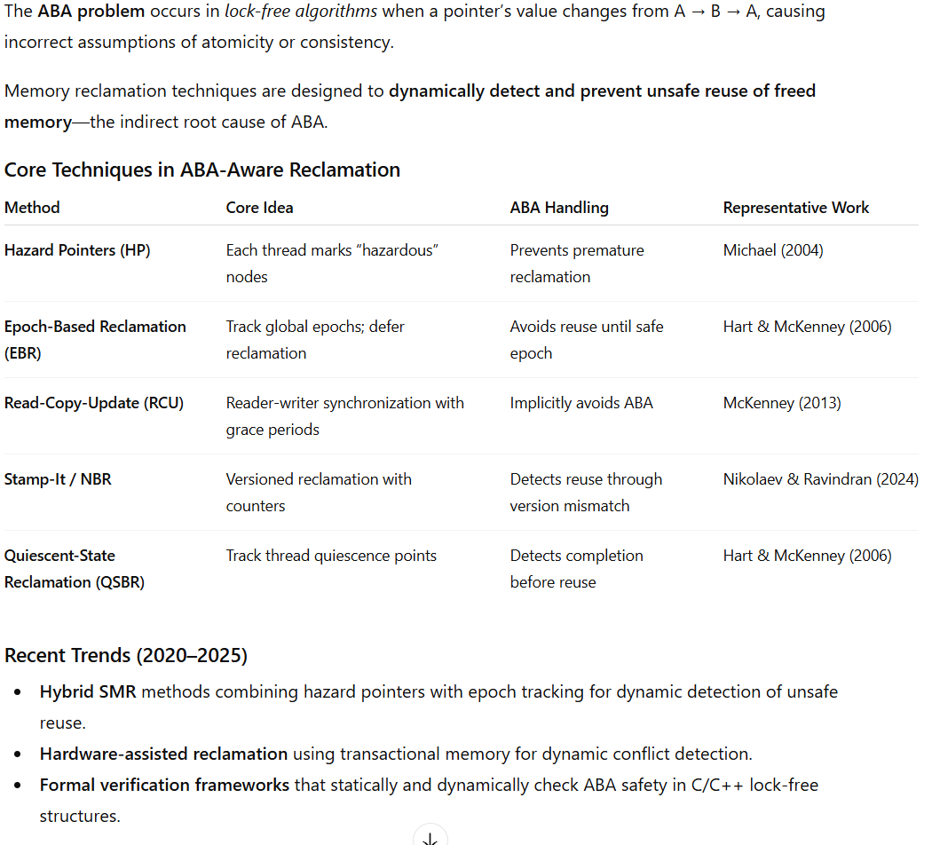
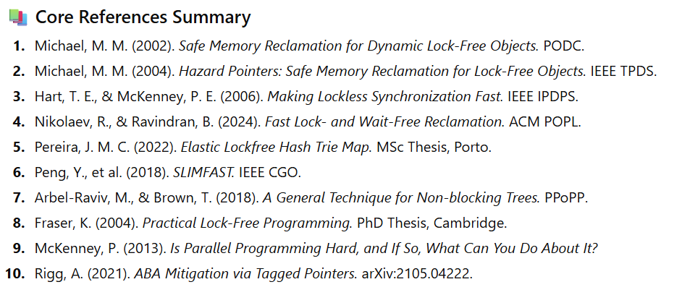
Ortogonal research topic: enabling ABA-detection in thread sanitizers

Slide 37
Optimizations and analysis around linearization points

Slide 38
Optimizations Enabled by Linearization Points – Motivation
In nonblocking structures, only critical memory accesses—for the most part, the linearizing load and compare-and-swap (CAS) instructions—need to occur atomically, while most pre-linearization memory accesses can safely be executed as they are encountered, and post-linearization accesses can be postponed until after the transaction commits [1].
1. Heavy Work AFTER the Linearization Point (Post-LP)
This is the most effective and common technique.
The Idea: The Linearization Point (LP) is the moment when an operation is considered logically complete. All physical restructuring of the data structure (tree rotations, removing nodes from memory) required to maintain invariants can be done later.
How this reduces collisions: If we try to do everything at once (insert a node + rotate the tree) in a single atomic transaction, we touch many memory addresses. Any other thread reading or writing to that area will cause a conflict. By splitting the phases, we narrow the "window of vulnerability."
Examples and Evidence:
Harris's Linked List:
This is a classic example. To remove a node, we first logically mark it as deleted (setting a bit in the next pointer—this is the LP, a single fast CAS).
The physical removal (swinging the pointers of the previous node) happens later and can be performed by any other thread.
Why this is an optimization: If we tried to atomically re-link the pointers immediately, we would need to lock or use a complex DCAS (Double CAS) on two nodes. Decoupling makes the linearization point instantaneous.
Relaxed Balanced Trees:
In standard trees (AVL, RB-Tree), insertion requires immediate rebalancing. This is expensive and causes contention at the root.
In Chromatic Trees (by T. Brown et al.) or Relaxed AVL trees, rebalancing is decoupled from insertion. You insert the node (LP passed) and leave. The tree is temporarily "unbalanced."
Brown, T., Ellen, F., & Ruppert, E. (2014). A general technique for non-blocking trees. They demonstrate that moving structural changes outside (after) the LP radically improves scalability.
2. Heavy Work BEFORE the Linearization Point (Pre-LP)
The Problem: A lock-free algorithm typically looks like a loop:
Read data (old_state).
Perform calculations (new_state = heavy_func(old_state)).
CAS(target, old_state, new_state).
If step 2 (calculations) takes a long time, another thread will likely change target while you are calculating. Your CAS will fail, and you will have to recalculate everything from scratch.
Conclusion: The heavier the computation inside the CAS loop, the higher the collision rate and wasted work.
The Optimization (Read-Only Phase): However, the optimization lies in moving everything that does not depend on the shared state outside of the CAS loop.
For example, memory allocation (new Node()) and its initialization with constants must be done before reading the shared variable on which the CAS will be performed.
3. RCU (Read-Copy-Update) — The Extreme Example
In RCU (heavily used in the Linux kernel), all the heavy work of creating a new version of a structure is done before the publication point (a single pointer store).
And all the heavy work of deleting the old version is done long after (when all readers have left).
[1] Wentao Cai, Haosen Wen, and Michael L. Scott. 2023. Transactional Composition of Nonblocking Data Structures. In Proceedings of the 35th ACM Symposium on Parallelism in Algorithms and Architectures (SPAA '23). Association for Computing Machinery, New York, NY, USA, 187–197. https://doi.org/10.1145/3558481.3591079

Slide 39
Optimizations Enabled by Linearization Points
1) Slimming Down the Hot Path Around LP
Why #1: In most concurrent data structures, the critical cost lies in CAS loops or critical sections. If the compiler knows the LP, it can:
Move non-essential work out of the retry loop (hashing, logging, statistics, allocations).
Relax atomic orders before LP (e.g., relaxed or monotonic) and keep strong ordering only at LP (e.g., release/acquire or acq_rel on the successful CAS).
This gives the biggest performance boost by reducing time spent in the hot path and minimizing CAS retries. Correctness is formally proven for C/C++11 and mainstream architectures (x86/ARM/Power). [cl.cam.ac.uk], [plv.mpi-sws.org], [conf.researchr.org]
Before (heavy work inside CAS loop (hot path))
bool stack_push(Node* node) {
while (true) {
Node* old = head.load(std::memory_order_relaxed);
node->next = old;
if (head.compare_exchange_weak(old, node, std::memory_order_acq_rel, std::memory_order_relaxed)) { // LP
auto h = compute_hash(node->data); // ❌ expensive inside loop
update_statistics(h);
return true;
}
}
After (expensive work moved out; strong ordering only at LP):
bool stack_push(Node* node) {
auto h = compute_hash(node->data); // outside hot path
while (true) {
Node* old = head.load(std::memory_order_relaxed);
node->next = old;
if (head.compare_exchange_weak(old, node, std::memory_order_release, std::memory_order_relaxed)) // LP
break;
}
update_statistics(h); // after LP
return true;

Slide 40
Compiler‑Integrated Linearizability Testing / Model‑Checking Instrumentation
A compiler (or build‑system) instruments operation boundaries and candidate LP edges to record histories (call, return, and atomic success). These traces are fed to automatic linearizability checkers that infer LPs by matching concurrent histories to sequential ones—without requiring explicit commit‑point annotation. Tools then produce a counterexample or a reproducible failing interleaving.
Why it’s production‑worthy.
Push‑button in CI: instrumentation is like ThreadSanitizer; the heavy lifting is in the checker.
Widely used frameworks: JetBrains Lincheck (CAV’23, ISSTA’24) integrated in Kotlin Coroutines and Java libs; Microsoft Line‑Up found real bugs in .NET concurrent classes; CheckFence checks consistency under relaxed memory. [link.springer.com], [eupp.github.io], [microsoft.com], [acg.cis.upenn.edu]
Gives high confidence that your static LP inference matches real behavior; also helps pinpoint “moving LP” bugs.
Potential effect.
Prevents correctness regressions when you do aggressive LP‑based optimizations.
Saves dev time by producing replayable traces for concurrency failures—shown to catch subtle bugs in production libraries. [microsoft.com], [link.springer.com]
Research coverage.
Line‑Up (PLDI’10): complete automatic checker for deterministic linearizability, no manual commit points. [microsoft.com]
CheckFence (PLDI’07): symbolic checking on relaxed memory models. [acg.cis.upenn.edu]
CoLT/CAV’10: model‑checking of heap‑based concurrent sets/lists. [link.springer.com]

Slide 41
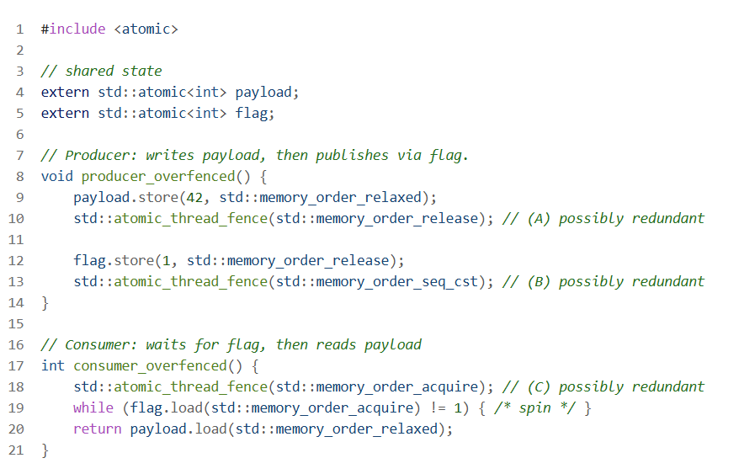
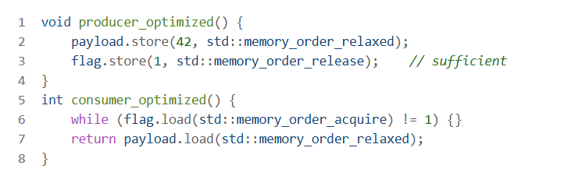
Memory model
Developer adds extra fences for safety — they work but are expensive (especially on ARM/Power).

Slide 42
Memory model
When “everything before LP can be relaxed” is really true
This rule works if:
Pre-LP state is not observed by other threads:
No one reads the node’s fields before it is published (linked into the structure).
No one relies on intermediate flags/fields updated before LP.
LP is correctly implemented:
Example (Treiber stack, push):
Initialize node->next = old_top; node->value = v; — plain writes (non-atomic).
Publish: top.compare_exchange_weak(old_top, node, std::memory_order_release, std::memory_order_relaxed);
Pop: read top with acquire to see a fully initialized node.
In this scheme, “everything before LP” can indeed be relaxed/non-atomic: release on CAS orders prior writes relative to the acquire observer.

Slide 43
Verification

Slide 44
Formalization, semantic verification
Mathieu Fehr, Yuyou Fan, Hugo Pompougnac, John Regehr, and Tobias Grosser. 2025. First-Class Verification Dialects for MLIR. Proc. ACM Program. Lang. 9, PLDI, Article 206 (June 2025), 25 pages. https://doi.org/10.1145/3729309
The core idea of the Fehr et al. (PLDI 2025) paper is to make formal semantics a first-class citizen in the MLIR ecosystem so that compiler verification tools can be built generically and reused across dialects.
Currently, MLIR dialects mostly define syntax and rely on informal semantics or implicit meaning through lowering. This makes it hard to verify optimizations, detect miscompilations, or reason about correctness. The paper proposes:
Semantic Dialects: A new family of MLIR dialects that encode the semantics of operations explicitly, including memory effects, undefined behavior, and poison values. These dialects can be lowered to SMT-LIB formulas for formal reasoning.
Separation of Concerns:
Compiler developers define semantics by lowering their dialect to these semantic dialects.
SMT experts optimize the encoding for solvers.
Tool builders create dialect-independent verification tools.
Reusable Tools: Using this infrastructure, they implement three generic tools:
Translation Validation: Checks that a transformation preserves semantics.
Peephole Rewrite Verification: Proves correctness of rewrite rules expressed in MLIR’s PDL dialect.
Dataflow Analysis Verification: Formally verifies transfer functions for static analyses like known bits and demanded bits.
Benefits:
Early formalization of IR semantics reduces bugs and ambiguity.
Enables automatic correctness proofs for optimizations and analyses.
Improves solver performance through domain-specific optimizations.
In short: Instead of bolting verification on later, the paper integrates semantics and verification into MLIR’s core design, enabling correctness guarantees for compiler passes and analyses with relatively low engineering cost.

Slide 45
Formalization, semantic verification
What problems Fehr’25 solves for our idea
Loss of semantic guarantees during lowering
Progress: An operation with progress="wait-free" can be lowered into an unbounded CAS loop → effectively blocking instead of wait-free.
Linearizability: LP markers may disappear or be moved incorrectly → atomicity breaks.
Memory order and scope: Misinterpretation of acquire/release, seq_cst, or scope (thread, system) → data races.
SMR invariants: Hazard pointers or epoch-based reclamation may lose protection → use-after-free bugs.
Optimizations without formal validation
Fence removal: Compiler removes fences thinking they are redundant → breaks happens-before guarantees.
LP reordering: Moving heavy work out of CAS loops can break correctness if LP semantics aren’t preserved.
Lock hoisting/sinking, transaction merging and etc.
Manual correctness checking is hard
LLVM IR introduces poison and UB, absent in MLIR → easy to make mistakes when mapping semantics.
Peephole rewrites with conditions (e.g., MUL(x,C) → SHL(x,log2(C))) require verification for all bit-widths and constants.
Progress and memory safety analyses (SMR) are difficult to validate without a formal model.

Slide 46
User cases

Slide 47
Optimizations Enabled by Linearization Points – Motivation
1. Context-Aware Specialization
A library (TBB, Folly) is written for the Generic Case. The library developer must assume the worst:
Thousands of writing threads.
Thousands of reading threads.
Different NUMA nodes.
Application Reality: A programmer takes this powerful folly::MPMCQueue but uses it in a scenario where:
There is only one producer and one consumer.
Or: the queue is almost always empty.
Or: the queue is processed in batches.
The Problem: The manual library code contains heavy CAS loops and Memory Fences designed for chaos. Even if if (is_single_threaded) were added to the library, it would be a runtime check.
Your Solution (The Compiler): Thanks to MLIR and LTO (Link Time Optimization), your compiler sees the Call Graph of the entire application.
It sees: "Aha, only the main_loop function writes to this queue instantiation, and only worker_thread reads from it."
It automatically Lowers the implementation from a heavy MPMC to a lightweight SPSC (Single-Producer Single-Consumer) Ring Buffer, removing expensive LOCK XCHG instructions and leaving lightweight store-release operations.
Result: The programmer writes safe code (using a standard library) but gets the performance of a custom hack.
3. SMR (Memory Reclamation) is Dynamic, not Static
Experts know how to place hp.protect(). This is true, but they do not know the load parameters.
Scenario: The user has "bursty" traffic.
Library: Implements standard Hazard Pointers or EBR with a fixed cleanup threshold (e.g., every 100 deletions).
Result: During peak load, this "standard threshold" causes massive latency spikes because the allocator chokes on free() calls.
Your Solution:
Your compiler can inject code (a scheduler) that "spreads" memory deallocation over time (as in the PPoPP'24 paper), based on the execution profile (PGO - Profile Guided Optimization).
A library is static; a compiler (especially JIT or PGO) can adapt the SMR strategy to the specific behavior of the program.
Who will be the User? (Target Audience)
You are absolutely right: the average "Joe Developer" will not write in "Concur MLIR Dialect" manually. Your stack will be used by:
Language and Runtime Creators (Rust, Go, Swift, Java HotSpot, .NET CLR).
  In Rust, for example, there is a huge pain point with Arc (atomic reference counting). The compiler cannot optimize it because it doesn't understand the semantics of "reference counting." If you give the Rust compiler a dialect that knows how to coalesce operations with Arc, Rust becomes 10-20% faster out of the box.
  Your product here: Backend optimization pass for LLVM/MLIR used by Rust/C++.
Next-Generation Libraries (Header-only C++ libs with Attributes).
  Imagine a new version of Folly or Abseil annotated with your attributes ([[concur::progress("wait-free")]], [[concur::role("producer")]]).
  The programmer writes normal C++ code and connects your plugin to Clang/LLVM.
  The Magic: If the programmer makes a mistake and creates a deadlock or violates a wait-free guarantee, the compiler throws an error at build time.
  Value: "Compile-time verification of concurrency properties." No one has this right now.
High-Frequency Trading (HFT) and GameDev.
  These are the people who currently write their own custom wheels because Folly is "too slow/bloated" for them.
  They will gladly adopt a tool that allows them to write clean code (like with Folly) but obtain binaries as fast as their handwritten "dirty" hacks.

Slide 48
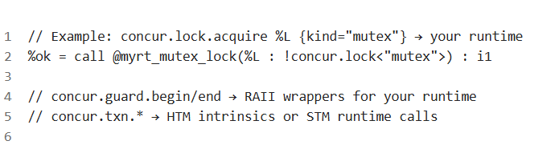
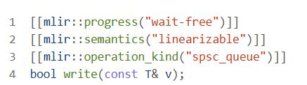
Workflow for libraries/tools
// folly/ProducerConsumerQueue.h - Real code
template<typename T>
class ProducerConsumerQueue {
std::atomic<unsigned int> readIndex_;
std::atomic<unsigned int> writeIndex_;
public:
[[mlir::progress("wait-free")]] // New annotation
[[mlir::semantics("linearizable")]]
[[mlir::operation_kind("spsc_queue")]]
bool write(const T& v) {
// Implementation...
}
};
What the Library Developer Must Do (Adapter Package)
Goal: Teach MLIR Concur how to lower your operations to runtime calls and unlock analysis/optimization benefits without breaking semantics.
Semantic Contract: Map your primitives to Concur types/attributes
  lock kinds: mutex|rwlock|spin|seqlock → your types/functions;
  progress: blocking|lock-free|wait-free;
  memory order/scope: acquire/release/... and thread|device|system;
  SMR: hazard-pointers|ebr|rcu (operations acquire/release, epoch.enter/exit, defer.free).
MLIR Lowering Pass (ConversionTarget + RewritePatterns)
Headers with Annotations for Source Code (so the frontend emits correct IR)

Slide 49
References
https://iris-project.org/
https://www.open-std.org/jtc1/sc22/wg21/docs/papers/2025/p0260r19.html -- proposal for Concurrent Queue for C++ standard

Slide 50
End of slides. Thanks for attention

